Slide 1
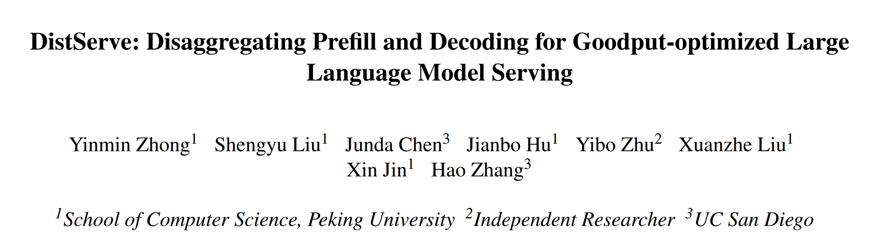

Slide 2
Background——Throughput vs. Goodput
Metric
Throughput: the number of request served per second——vLLM, TensorRT-LLM
Goodput: the number of completed requests per second that adheres to SLOs——DistServe

Slide 3
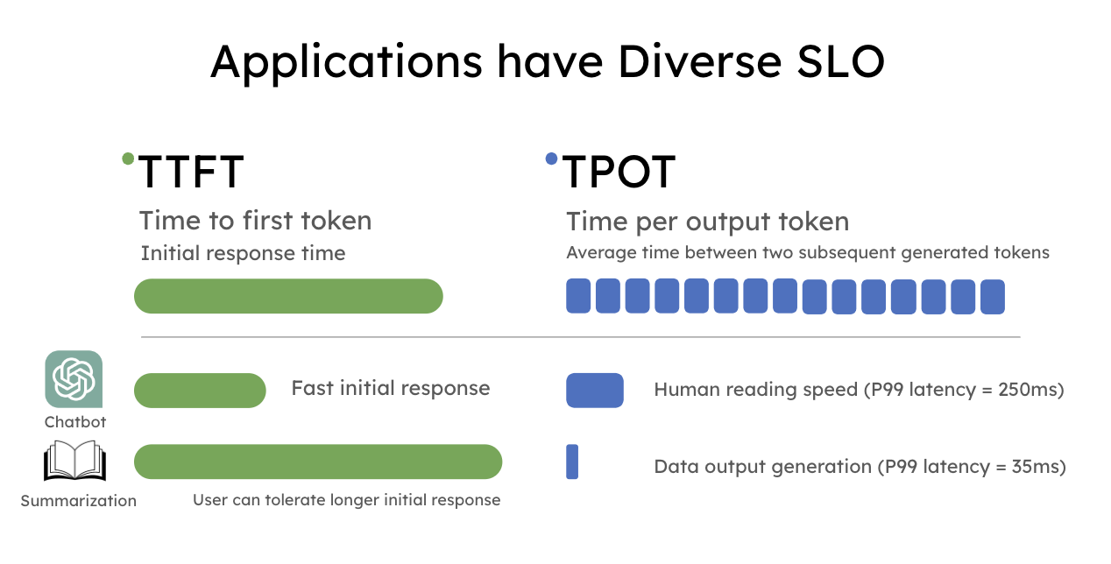
Background——Throughput vs. Goodput
Metric
Throughput: the number of request served per second——vLLM, TensorRT-LLM
Goodput: the number of completed requests per second that adheres to SLOs——DistServe

Slide 4
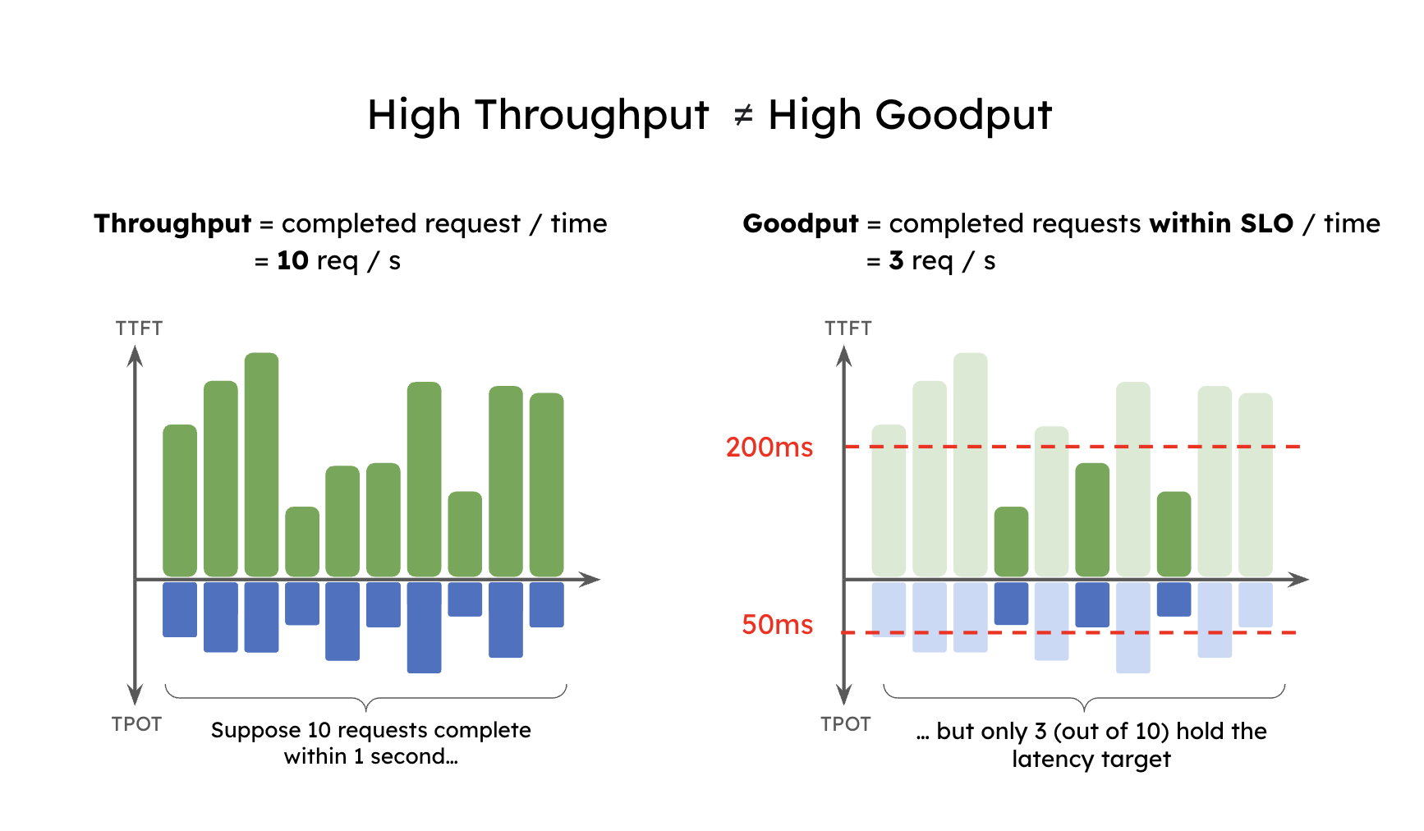
Background——Throughput vs. Goodput
Metric
Throughput: the number of request served per second——vLLM, TensorRT-LLM
Goodput: the number of completed requests per second that adheres to SLOs——DistServe

Slide 5
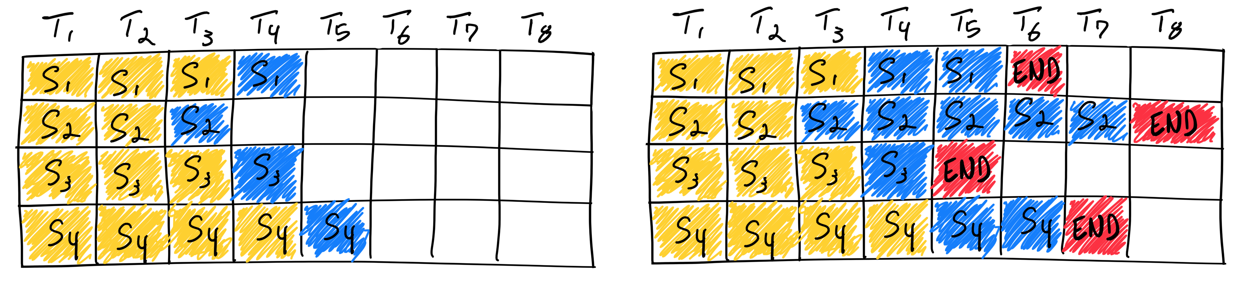
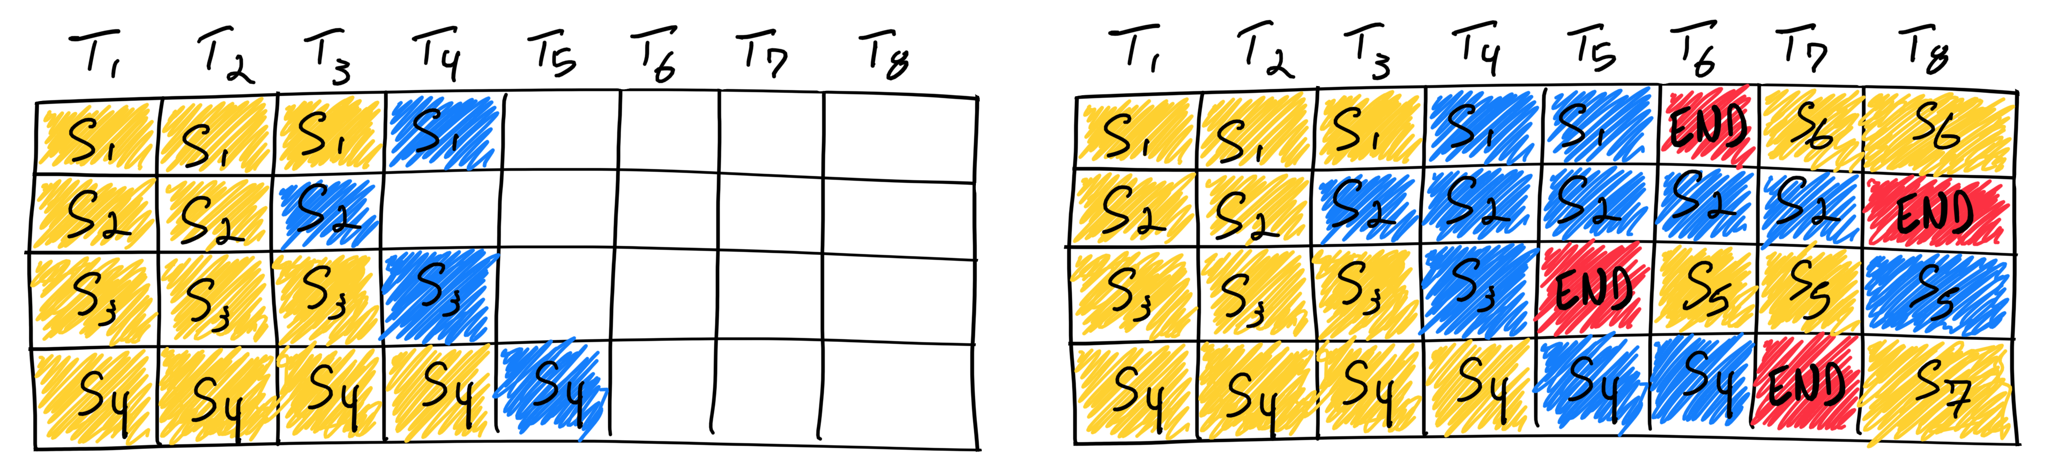
Background——LLM Serving Optimization
Batching
Static batching
Continuous batching

Slide 6
Background——LLM Serving Optimization
Batching
Model Parallelism
Intra-operator parallelism (Tensor Parallelism)
Inter-operator parallelism (Pipeline Parallelism)

Slide 7
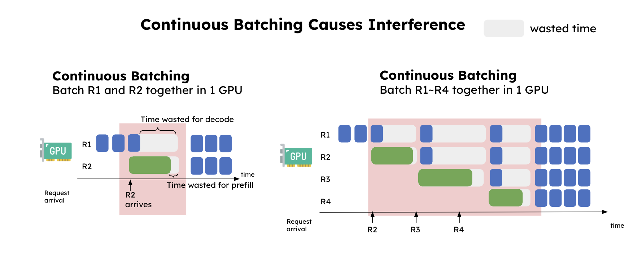
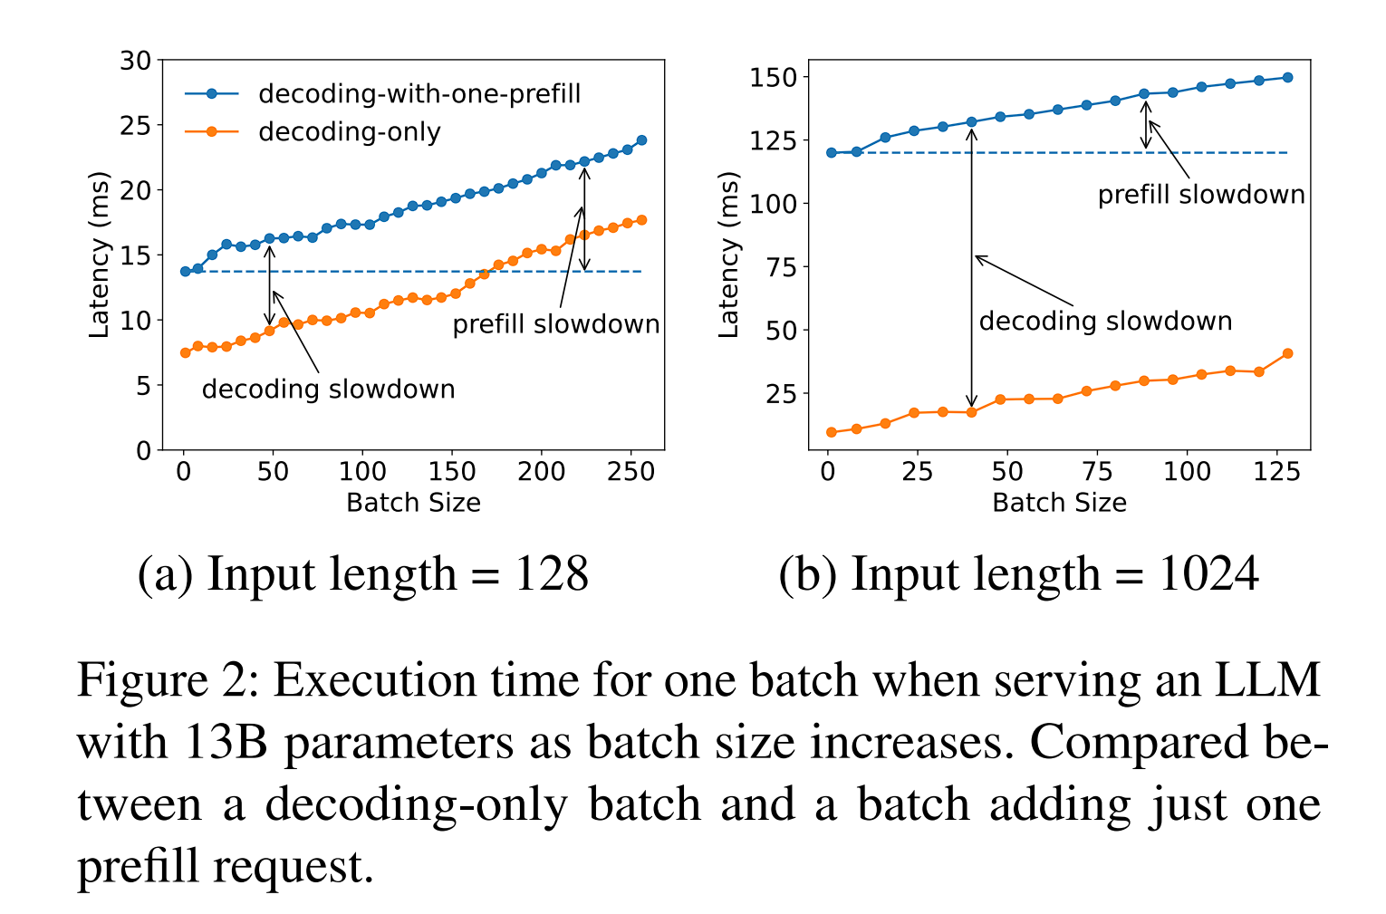
Colocation Problems
Prefill-decoding interference

Slide 8
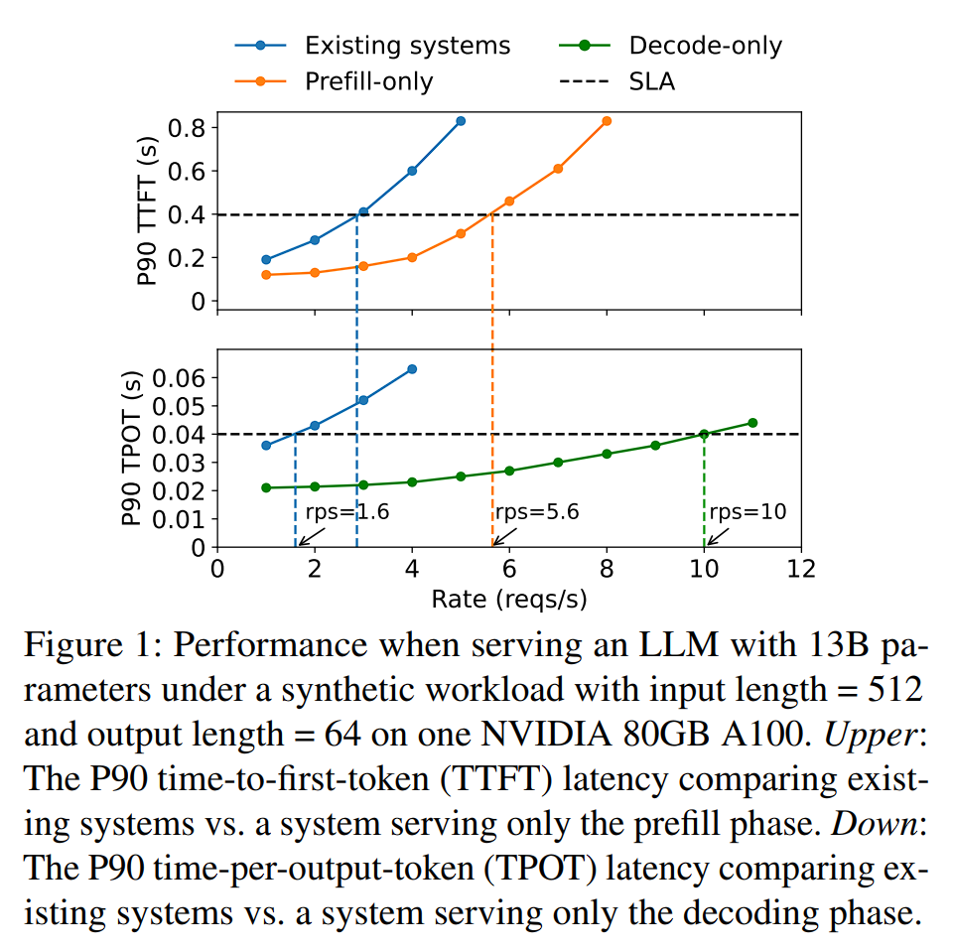
Colocation Problems
Prefill-decoding interference

Slide 9
Colocation Problems
Prefill-decoding interference
Resource and parallelism coupling
Prefill and decode have distinct computation patterns and latency goals

Slide 10
Opportunities
Disaggregate prefill and decode phases
Naturally enables each to focus on its optimization target – TTFT or TPOT.
Each can employ different resources and parallelism strategies to meet a variety of latency requirements

Slide 11
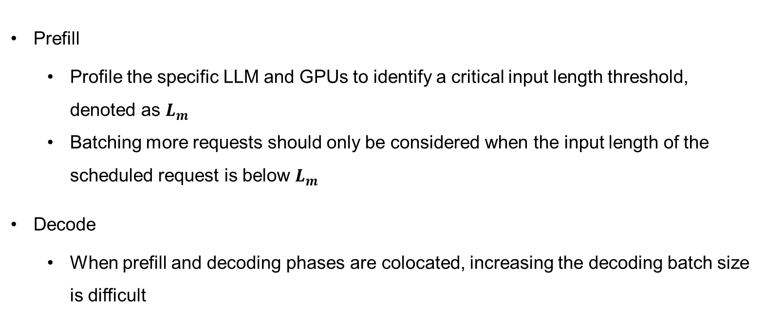
Tradeoff Analysis Post Disaggregation——Batching Strategy
Prefill
Profile the specific LLM and GPUs to identify a critical input length threshold, denoted as $L_{m}$
Batching more requests should only be considered when the input length of the scheduled request is below $L_{m}$
Decode
When prefill and decoding phases are colocated, increasing the decoding batch size is difficult

Slide 12
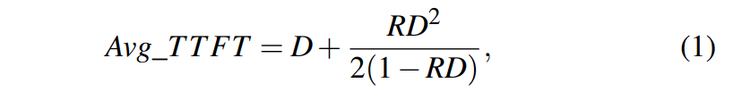
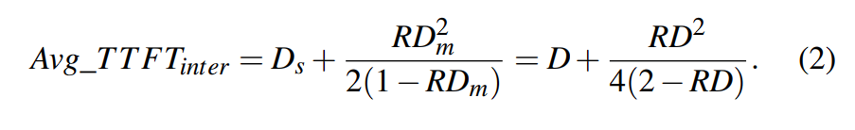
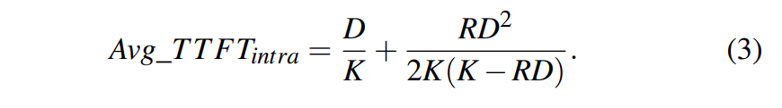
Tradeoff Analysis Post Disaggregation——Parallelism plan
Prefill——Disaggregation enables the prefill phase to function analogously to an M/D/1 queue
Single device
2-way inter-op parallelism
2-way intra-op parallelism
D: Each request’s execution time
R: Poisson arrival rate
K: Speedup coefficient influenced by communication

Slide 13
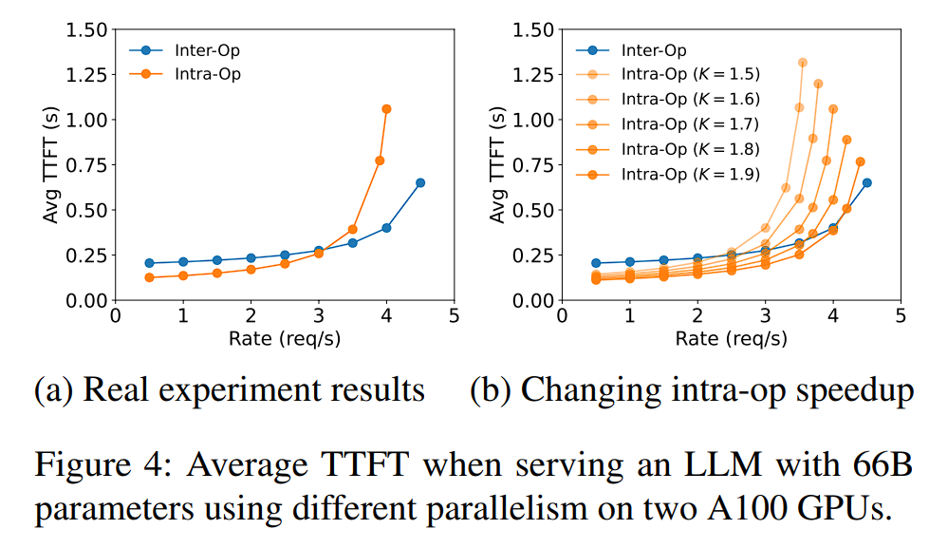
Tradeoff Analysis Post Disaggregation——Parallelism plan
Prefill——Disaggregation enables the prefill phase to function analogously to an M/D/1 queue
Single device
2-way inter-op parallelism
2-way intra-op parallelism
D: Each request’s execution time
R: Poisson arrival rate
K: Speedup coefficient influenced by communication

Slide 14
Tradeoff Analysis Post Disaggregation——Parallelism plan
Decode
Post-disaggregation, the batch size for decoding is constrained by GPU memory capacity
Relieve KV cache: Paged-Attention and GQA
As the decoding batch size continue to increase to approach the compute bound, the decoding computation begins to resemble the prefill phase

Slide 15
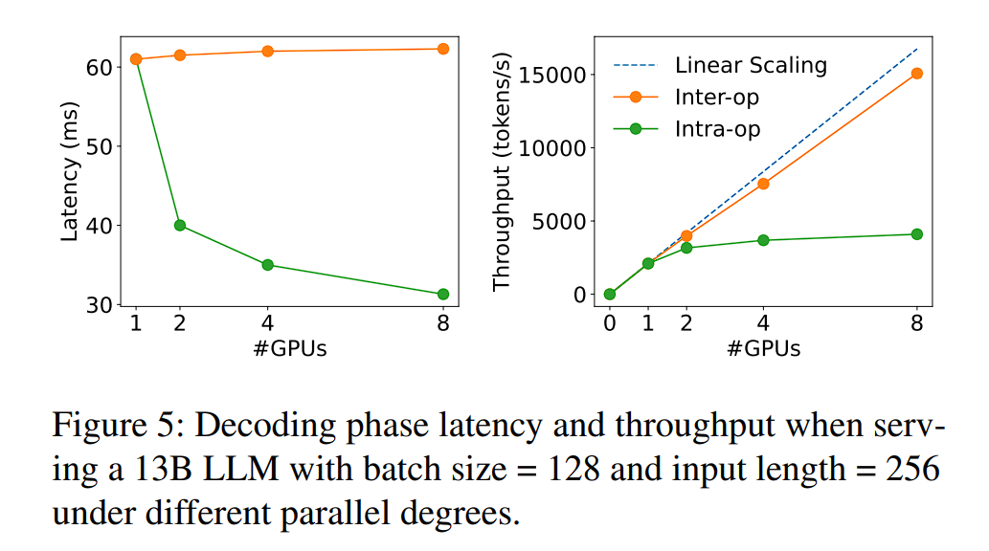
Tradeoff Analysis Post Disaggregation——Parallelism plan
Decode
Post-disaggregation, the batch size for decoding is constrained by GPU memory capacity
Relieve KV cache: Paged-Attention and GQA
As the decoding batch size continue to increase to approach the compute bound, the decoding computation begins to resemble the prefill phase

Slide 16
Method
Target
Given the model, workload characteristic, latency requirements and SLO attainment target , find a placement that maximizes the per-gpu goodput

Slide 17
Method
Target
Given the model, workload characteristic, latency requirements and SLO attainment target , find a placement that maximizes the per-gpu goodput
Placement for High Node-Affinity Cluster

Slide 18
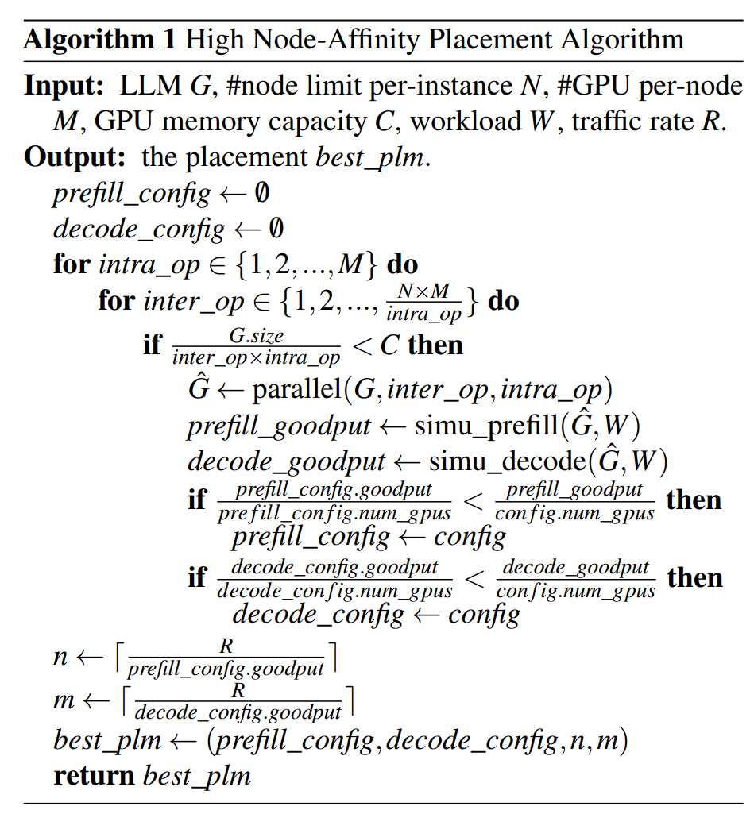
Method——Placement for High Node-Affinity Cluster
Build a simulator to estimate the SLO attainment
Use history request traces
Traverse parallel config to simulate
Replicate best config to achieve overall traffic rate

Slide 19
Method
Target
Given the model, workload characteristic, latency requirements and SLO attainment target , find a placement that maximizes the per-gpu goodput
Placement for High Node-Affinity Cluster
Placement for Low Node-Affinity Cluster

Slide 20
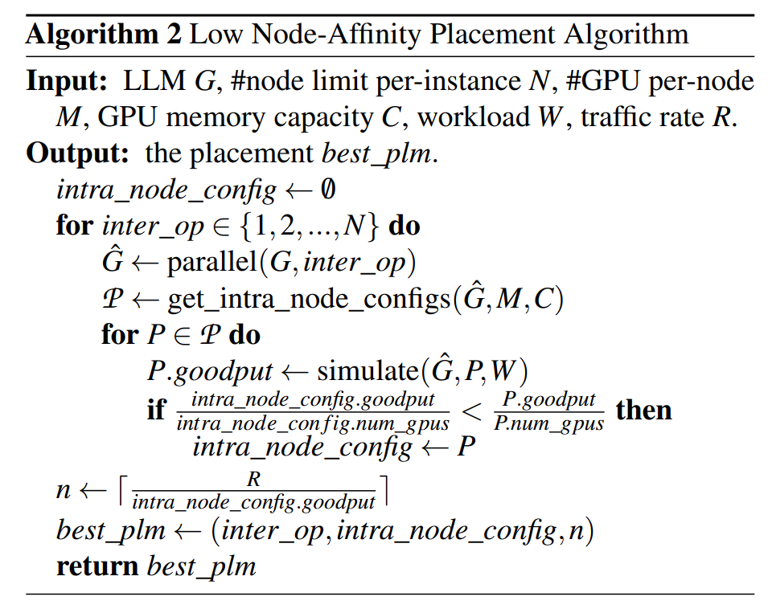
Method——Placement for Low Node-Affinity Cluster
Colocate prefill and decoding segments of the same stage within a single node

Slide 21
Method
Target
Given the model, workload characteristic, latency requirements and SLO attainment target , find a placement that maximizes the per-gpu goodput
Placement for High Node-Affinity Cluster
Placement for Low Node-Affinity Cluster
Online scheduling

Slide 22
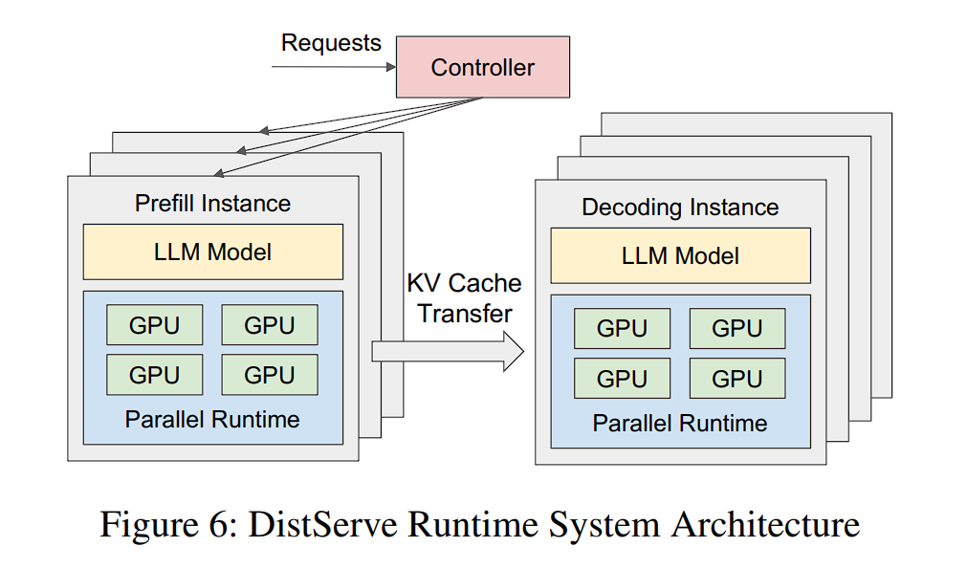
Method——Online scheduling
Reducing pipeline bubbles——batch request to saturate the GPU
Combat busrtiness——pull method for KV
Replaning——trigger rerun placement algorithm

Slide 23
Evaluation
Setup
4 nodes and 32 GPUs. Each node has 8 NVIDIA SXM A100-80GB GPUs connected with NVLINK
OPT 13B/66B/175B
Chatbot, Code Completion, Summarization

Slide 24
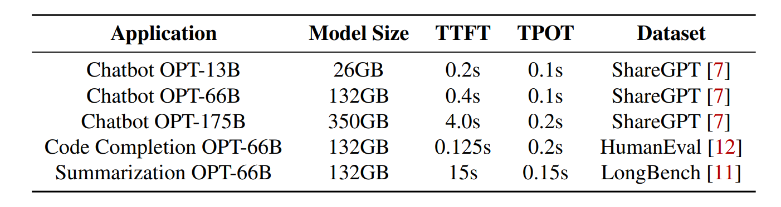
Evaluation
Setup
4 nodes and 32 GPUs. Each node has 8 NVIDIA SXM A100-80GB GPUs connected with NVLINK
OPT 13B/66B/175B
Chatbot, Code Completion, Summarization
Metrics: SLO attainment(90%)
Baseline: vLLM

Slide 25
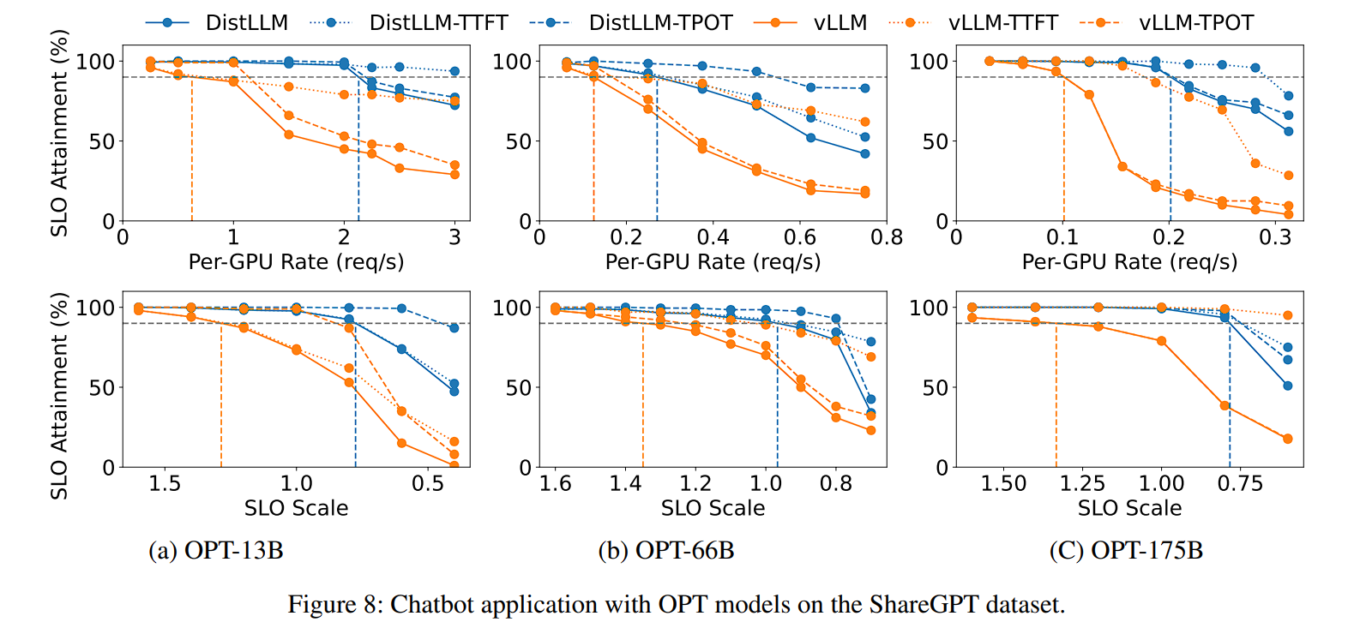
Evaluation——End-to-end Experiments
Chatbot
DistServe can sustain 2.0×-3.41× higher request rate compared to vLLM
DistServe can achieve 1.4×–1.8× more stringent SLO than vLLM
OPT175B placement: prefill: inter-op =3, intra-op = 3; decoding: inter-op = 3, intra-op = 4

Slide 26
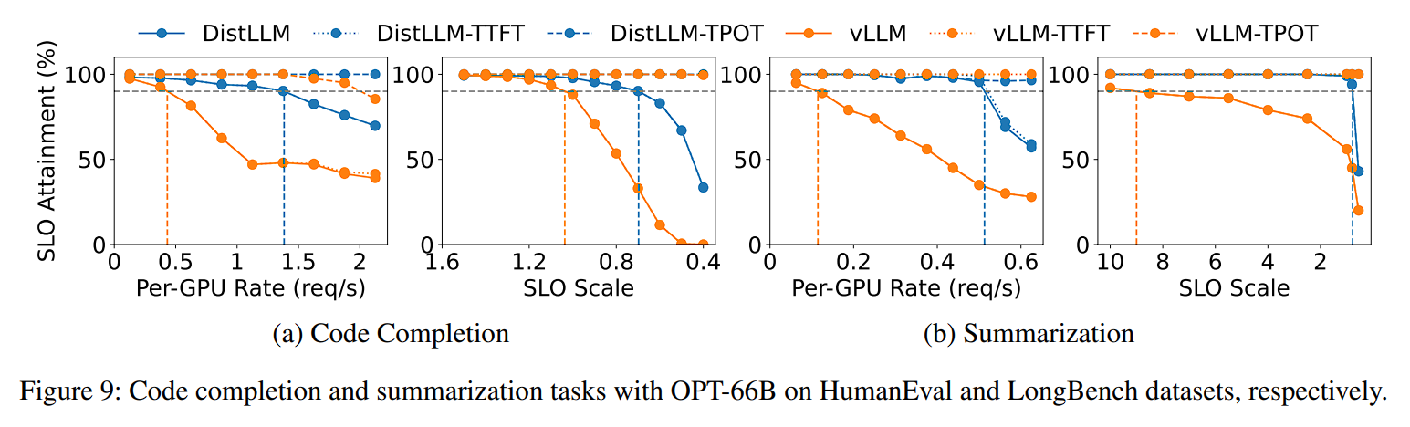
Evaluation——End-to-end Experiments
Code Completion
DistServe can sustain 3.2× higher request rate and 1.5× more stringent SLO than vLLM
Summarization
DistServe achieves 4.48× higher request rate and 10.2× more stringent SLO than vLLM

Slide 27
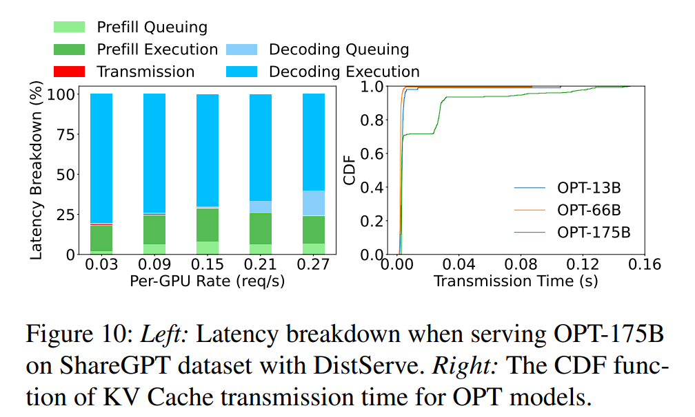
Evaluation——Latency Breakdown
Even for OPT-175B, the KV Cache transmission only accounts for less than 0.1% of the total latency
Over 95% of requests experience a delay of less than 30ms

Slide 28
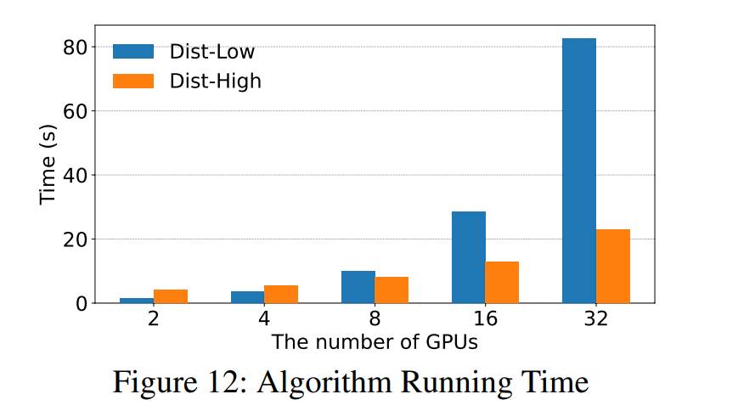
Evaluation——Algorithm Running Time
Execution time of the algorithm is in minutes

Slide 29
Summary
DistLLM is an end-to-end distributed serving system disaggregating prefill and decoding
No interference between prefill and decode
Decoupled resource allocation and parallelism strategy

Slide 30
Related Work
工作 | 公开 | 时间 | 单位 | 平台
华为海思 LLM Engine | 否 | 2023 | 华为海思 | 自研
Splitwise | 是 | 2023 Dec | 微软 | vLLM
DistServe | 是 | 2024 Jan | 北大 | vLLM
TetriServe | 是 | 2024 Jan | 华为云+计算所 | vLLM
Dejavu | 是 | 2024 Mar | ETH | FT

